Slide 1

Motivation of this Workshop
Emma de Oña Wilhelmi & Ruben Lopez Coto for the HONEST3 SOC

Slide 2
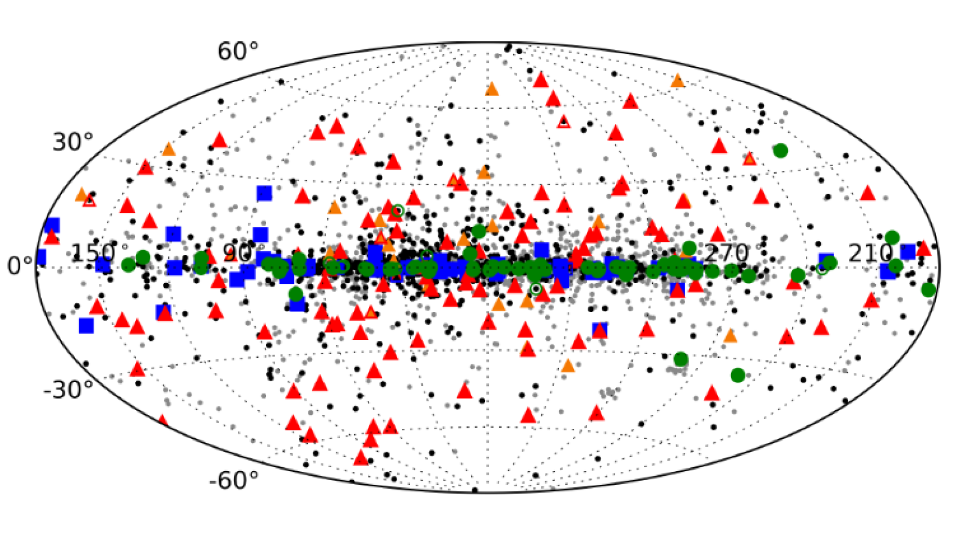
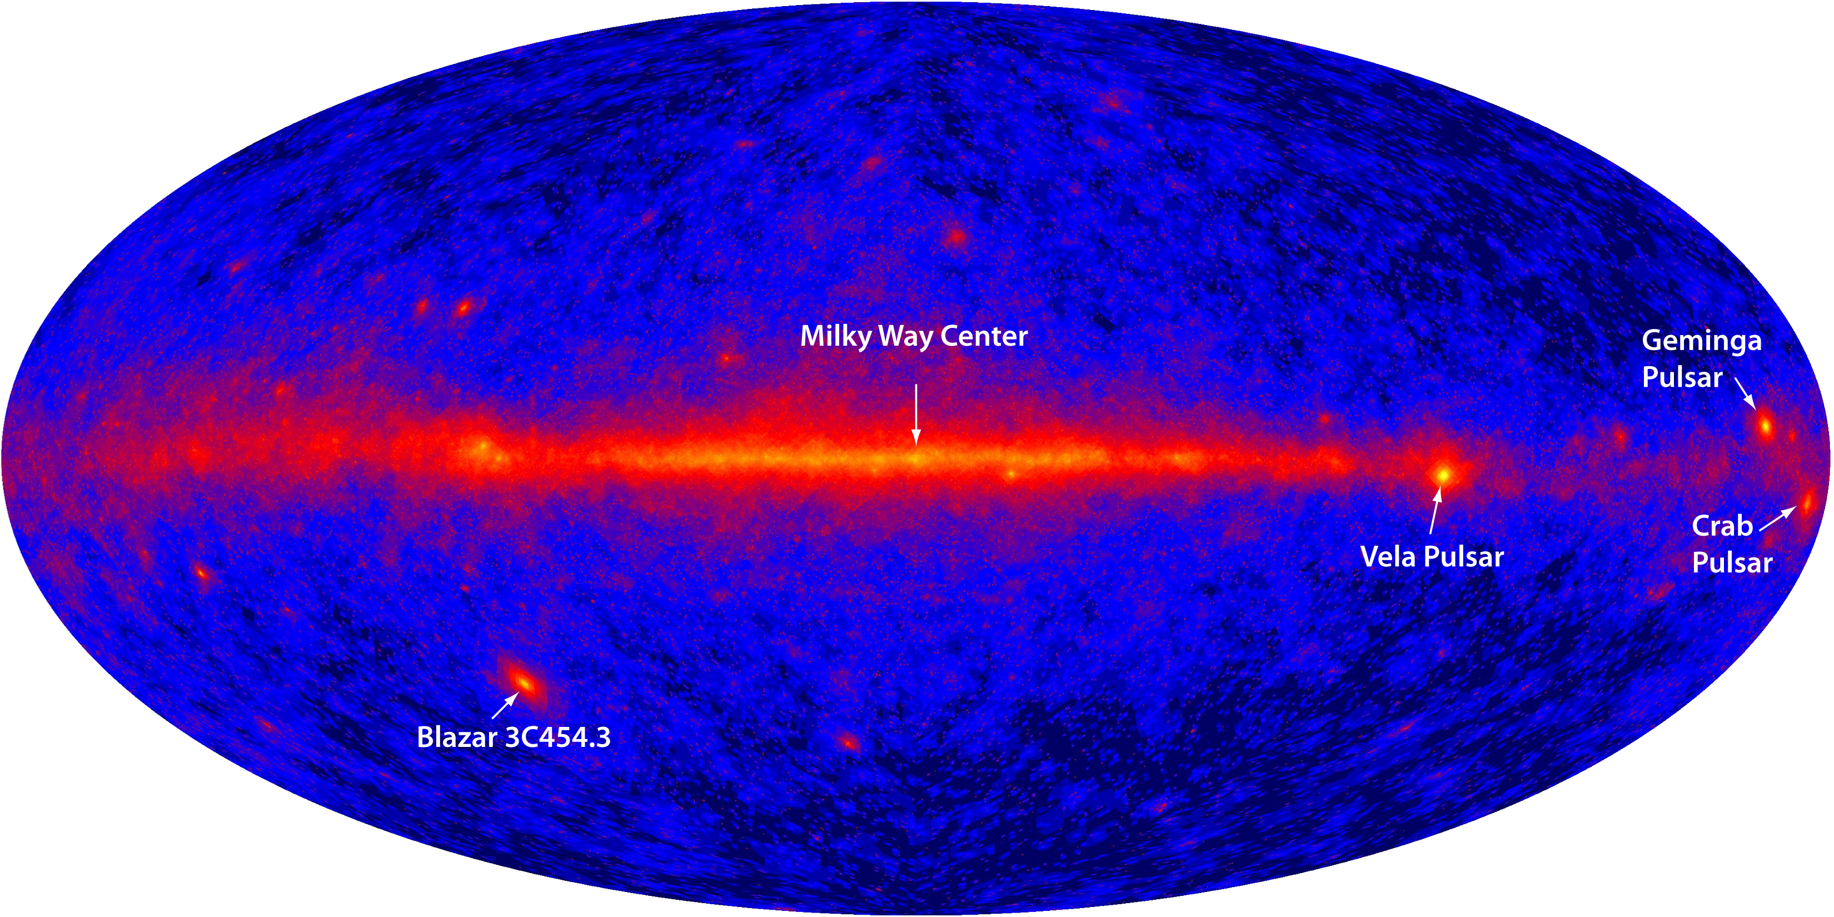
The Fermi LAT Legacy
Image credit: the International Fermi LAT Collaboration.
Gamma-ray sky at 1 GeV
Pulsars are brightest Galactic sources at 1 GeV and the most numerous Galactic source population

Slide 3
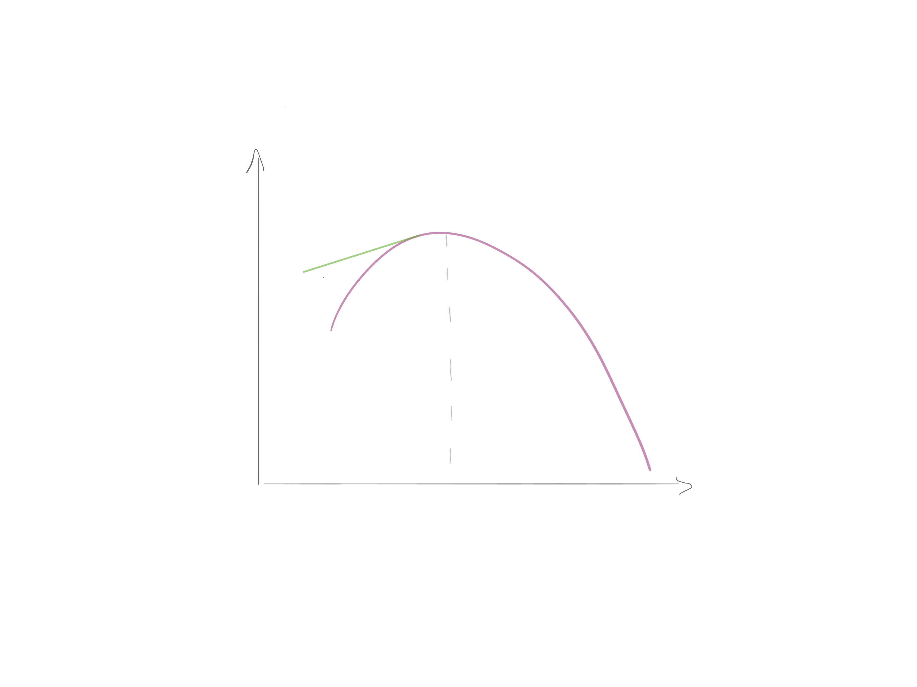
The Fermi LAT Legacy
High Ė pulsars
Broad peaks
E²dN/dE
Slow decaying
E_{o}
Energy
Peak at lower energies

Slide 4
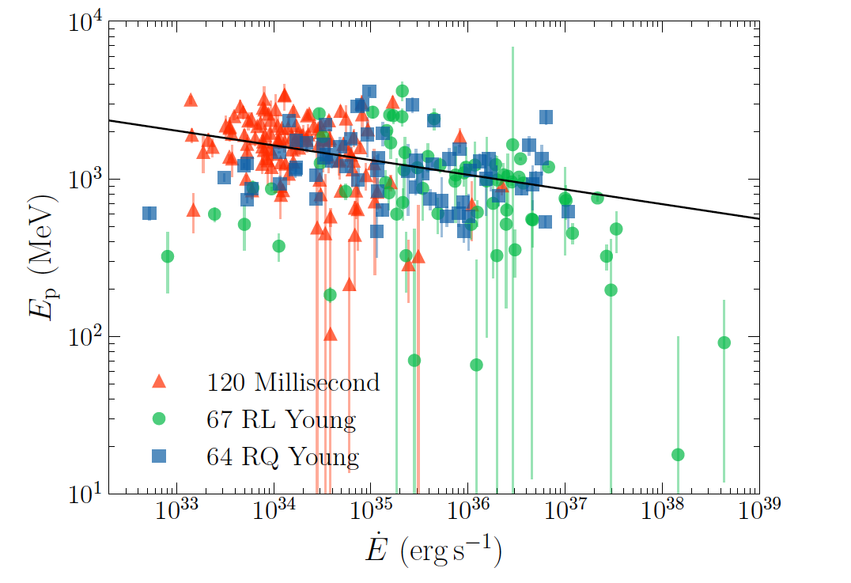
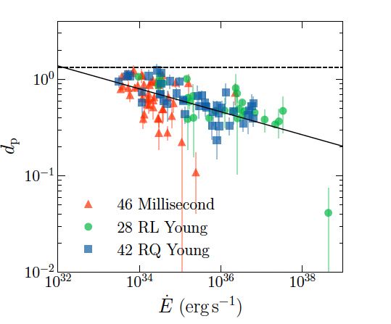
The Spectrum in the GeV regime
3PC, LAT Collaboration 2023
High Ė pulsars
Broad peaks
E²dN/dE
Narrow peak
Broad peak
E_{o}
Slow decaying
Energy
Peak at lower energies

Slide 5
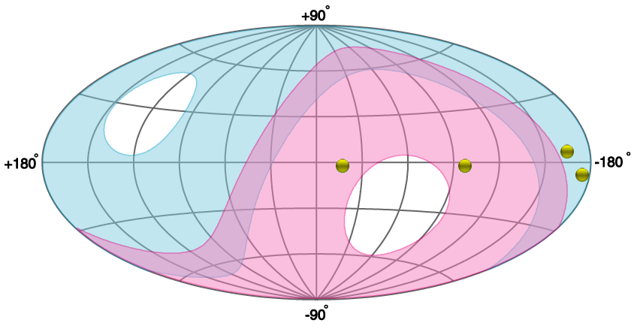
IACTs gamma-ray pulsars
Northern Hemisphere
Vela
Geminga
Crab
PSR B1706-44
Southern Hemisphere
TeVCat

Slide 6
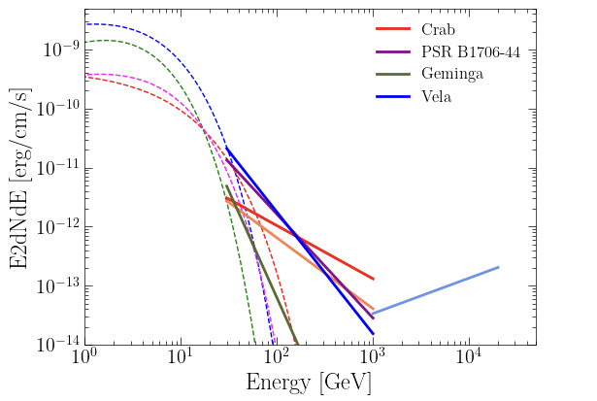
New phenomenology:
Tails extending beyond the expected synchrotron-curvature energy cutoff
New component raising >> tens of TeV (IC scattering)
 | Age [kyr] | D [kpc] | Ė/d² [erg/s/kpc²] | ~E_{max} [TeV] | Γ_{VHE}
Crab | 1.2 | 2 | 5x10³⁸ | 1.5 | 3. – 3.5
PSR B1706-44 | 18 | 2.6 | 6x10³⁵ | 0.075 | 3.76
Geminga | 340 | 0.2 | 7x10³⁵ | 0.070 | 5.62
Vela | 11 | 0.3 | 1x10³⁸ | 0.1 | 4.1
Vela+ |  |  |  | 20 | 1.4
More coming…

Slide 7
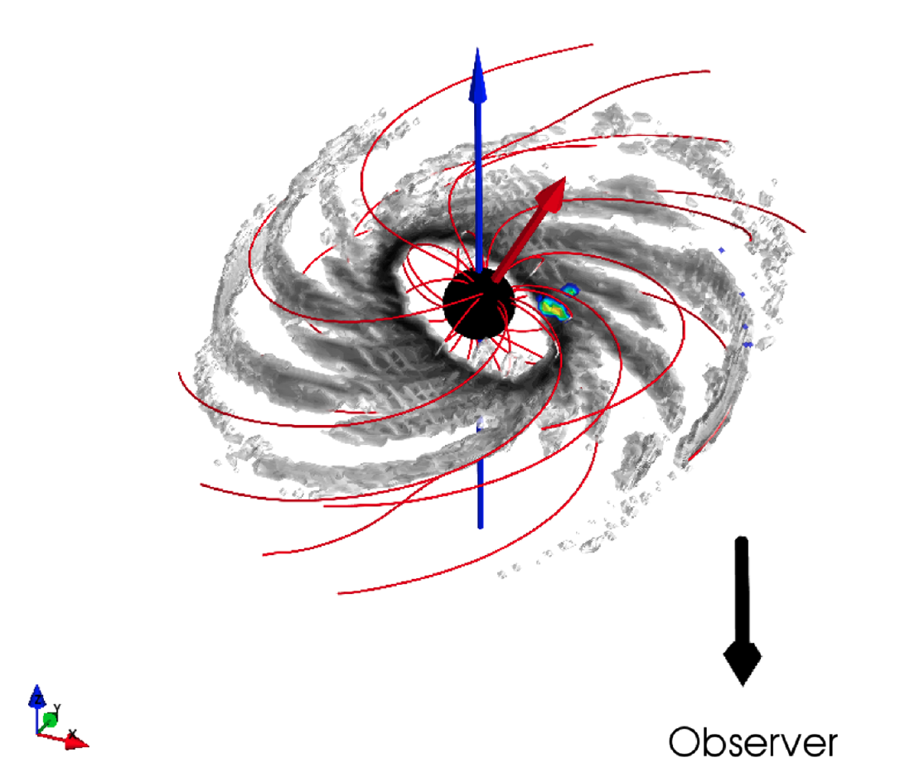
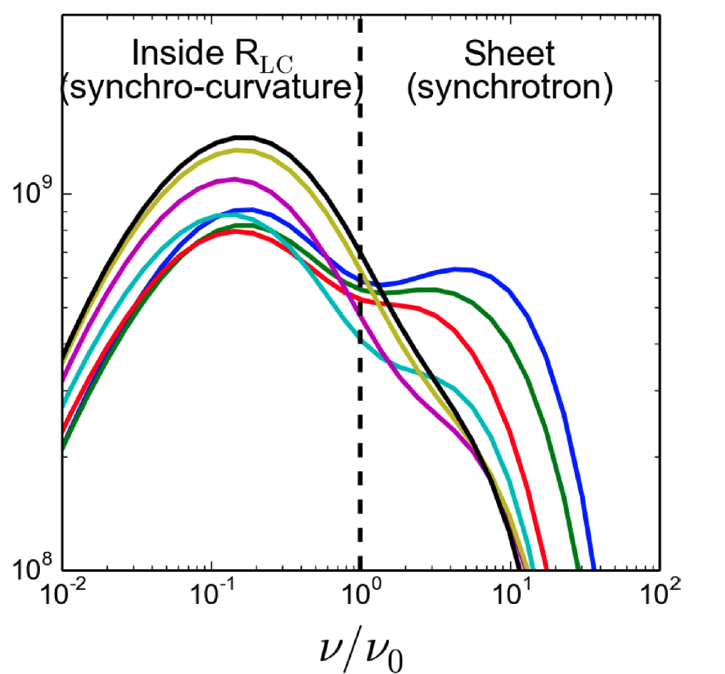
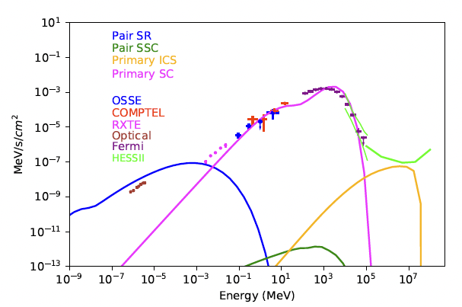
Meanwhile in the theory side…
Systematic modelling of pulsar light curves and spectra
=> Most particle acceleration occurs high in the magnetosphere and/or beyond
=> Multiple acceleration regions/components - Gaps vs Stripped winds
Cerutti et al 2016
Harding et al 2021
Notes:
The dissipative magnetospheres have been used to model the high-energy emission from pulsars [62], [19], [135], showing that the acceleration and emission is widely distributed over the magnetosphere, concentrating in lobes over the polar cap for small conductivity, but progressively moving to the open field boundary and out to the current sheet beyond the light cylinder for high conductivity.
over the last forty years, the favored site of pulsar high-energy emission has migrated from near the polar caps, to the outer magnetosphere, to outside the light cylinder.

Slide 8
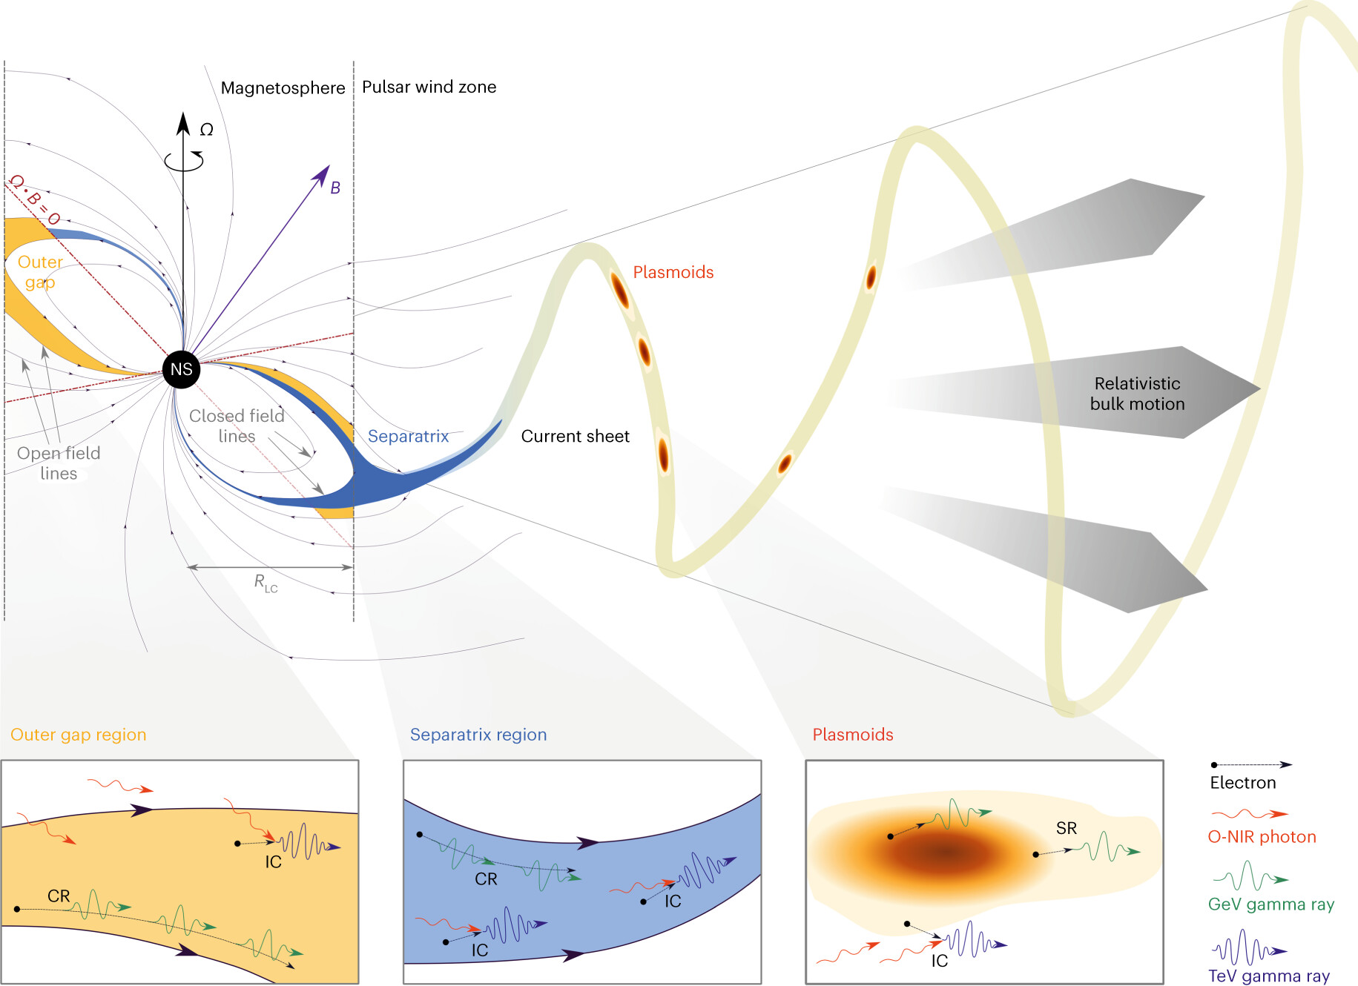
(i) Magnetospheric models
accelerating E||, charge
depleted zones; CR / IC
HESS Collaboration et al 2023
HESS Collaboration et al 2023
(ii) Wind models:
Magnetic reconnection
current sheet; non-ideal MHD;
SR / IC
Notes:
two-step process: the acceleration occurs deep in the CS where the magnitude of the perpendicular B-field is weak and is followed by abrupt SR cooling in the magnetic loops (plasmoids) where B-field is strong

Slide 9
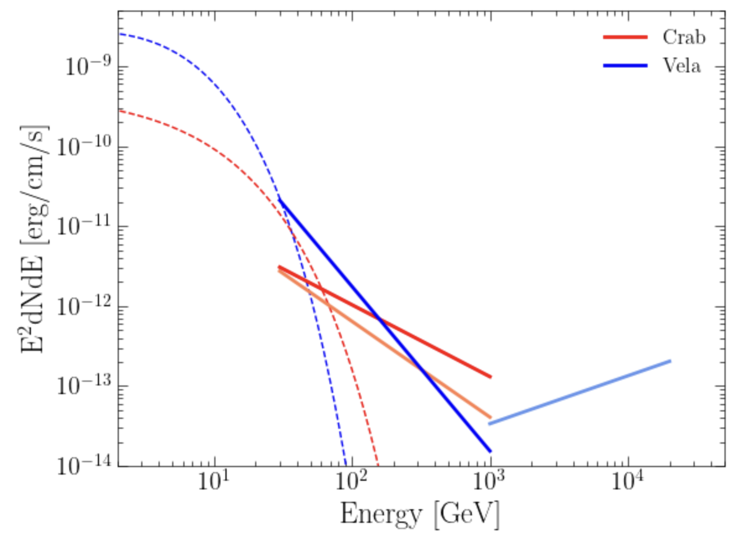
Open Questions and ongoing activities
What‘s the nature of the tails? Inverse Compton? Where is the radiation produced?
What‘s the nature of the multi-TeV component? Are there more pulsars like Vela? Surely there are!
What about Crab?
What can we learn?
Is the density of the electrons ~ ρ_{GJ}
Maximum Lorentz factor / Energy
Constrains on the Op/IR photon fields
Extreme e⁺⁻ accelerators => Cosmic ray electrons
?

Slide 10
Summary
Opening the pulsed TeV emission
Four (five) pulsars have been detected with IACTs
Despite the long observation times used for the first ones, the new discoveries are reachable in moderated time (Tobs < 100 h)
These detections open more questions and boost the field of pulsars
  An unambiguous handle on Lorentz factors > 4x10⁷
  VHE emission, i.e. dissipation region beyond but close to LC (even in the Doppler-boosted scenario)
  Challenges for both CR/IC and SR/IC scenarios
  On the upcoming of CTAO, and still profiting of the current generation of IACTs, it is a good time to bring together the community to discuss theory and experimental results. Let’s start!

Slide 11
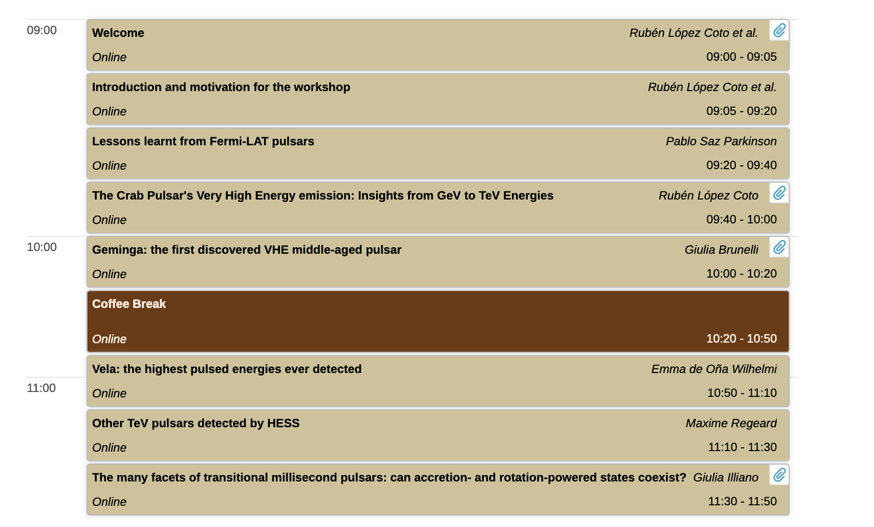
Experimental results
TeV Pulsars

Slide 12
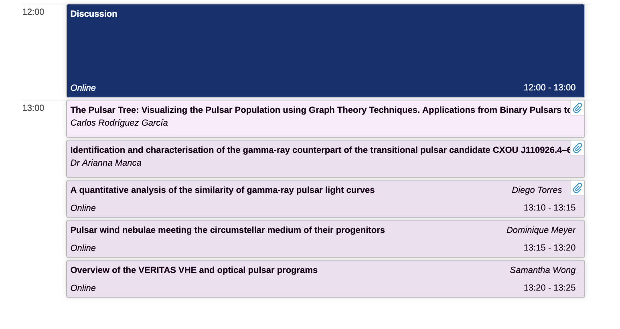
Experimental results
TeV Pulsars

Slide 13
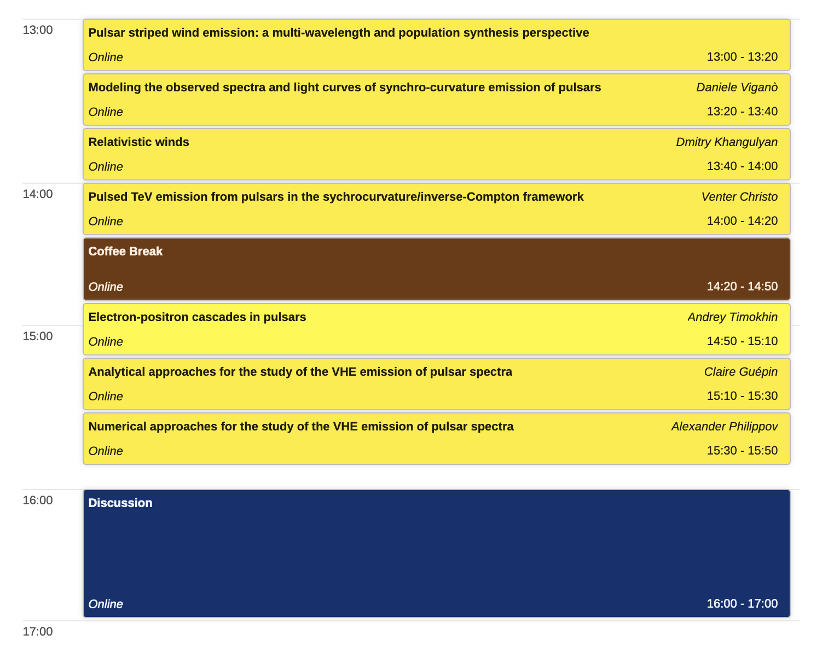
Theoretical Advances
TeV Pulsars

Slide 14
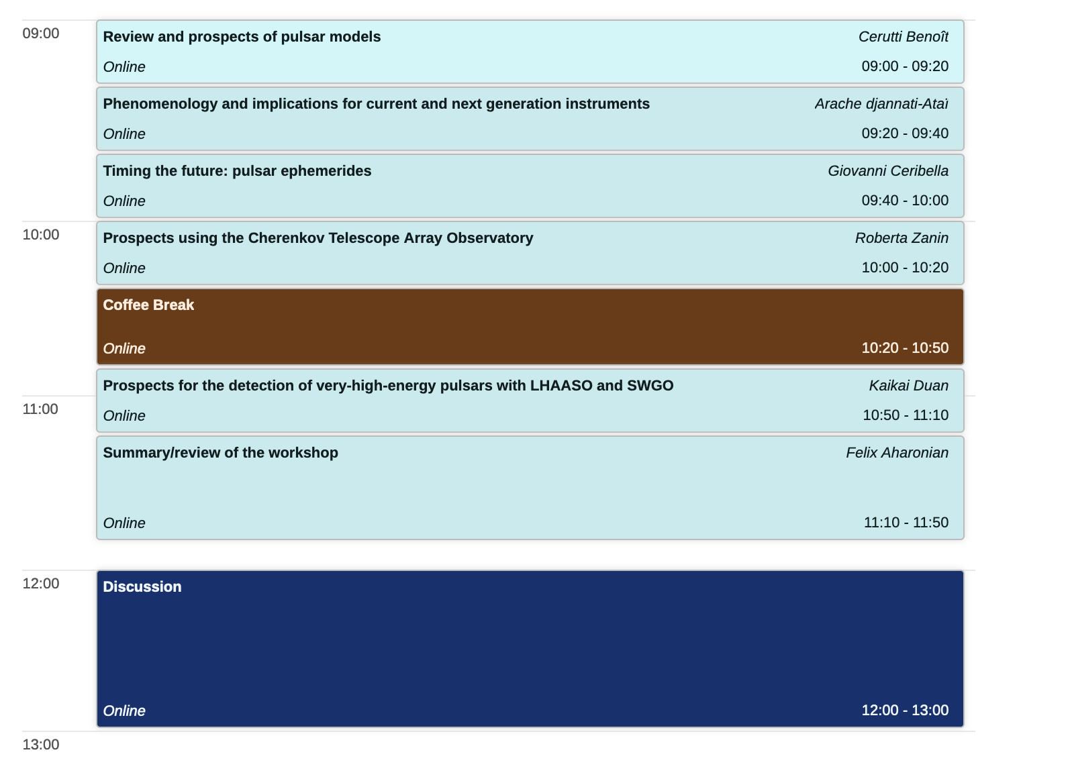
Prospects and Future
TeV Pulsars

Slide 15
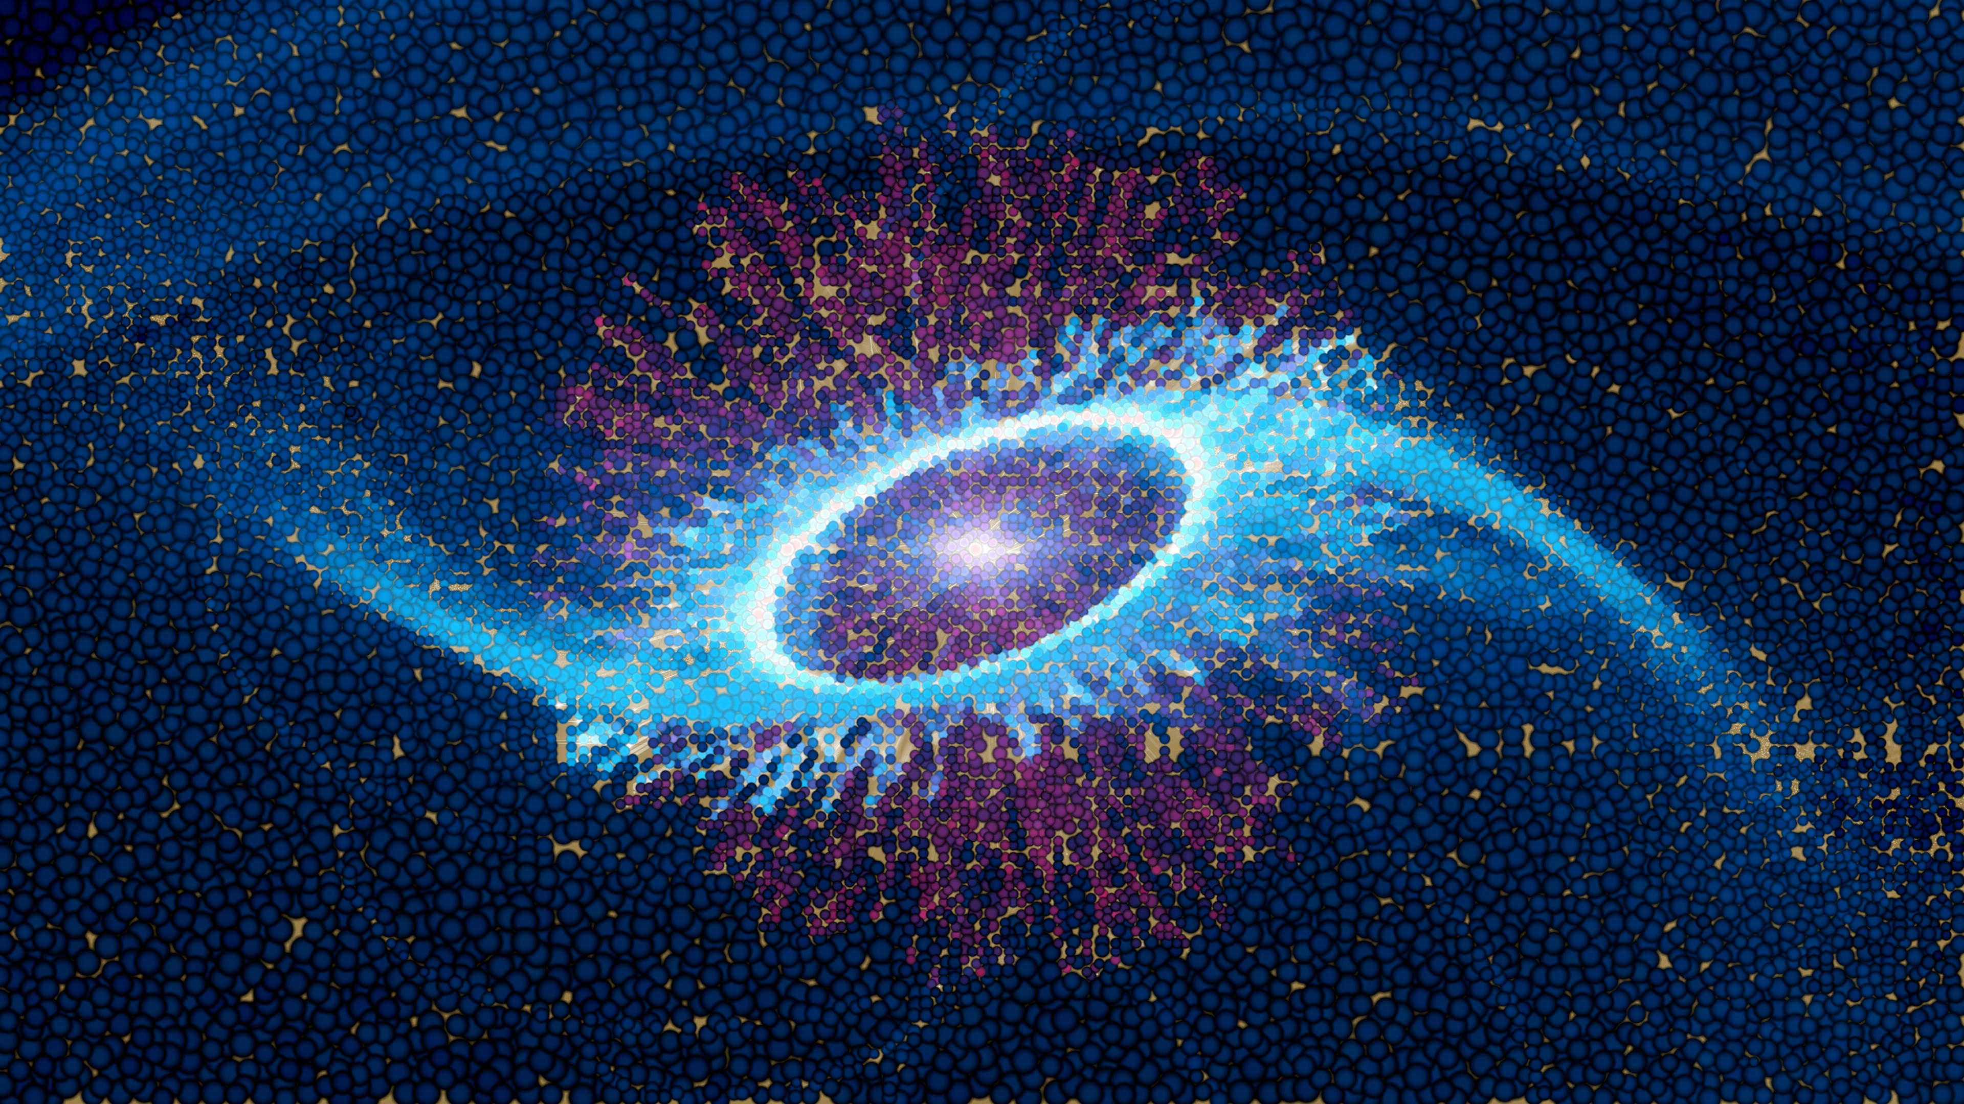
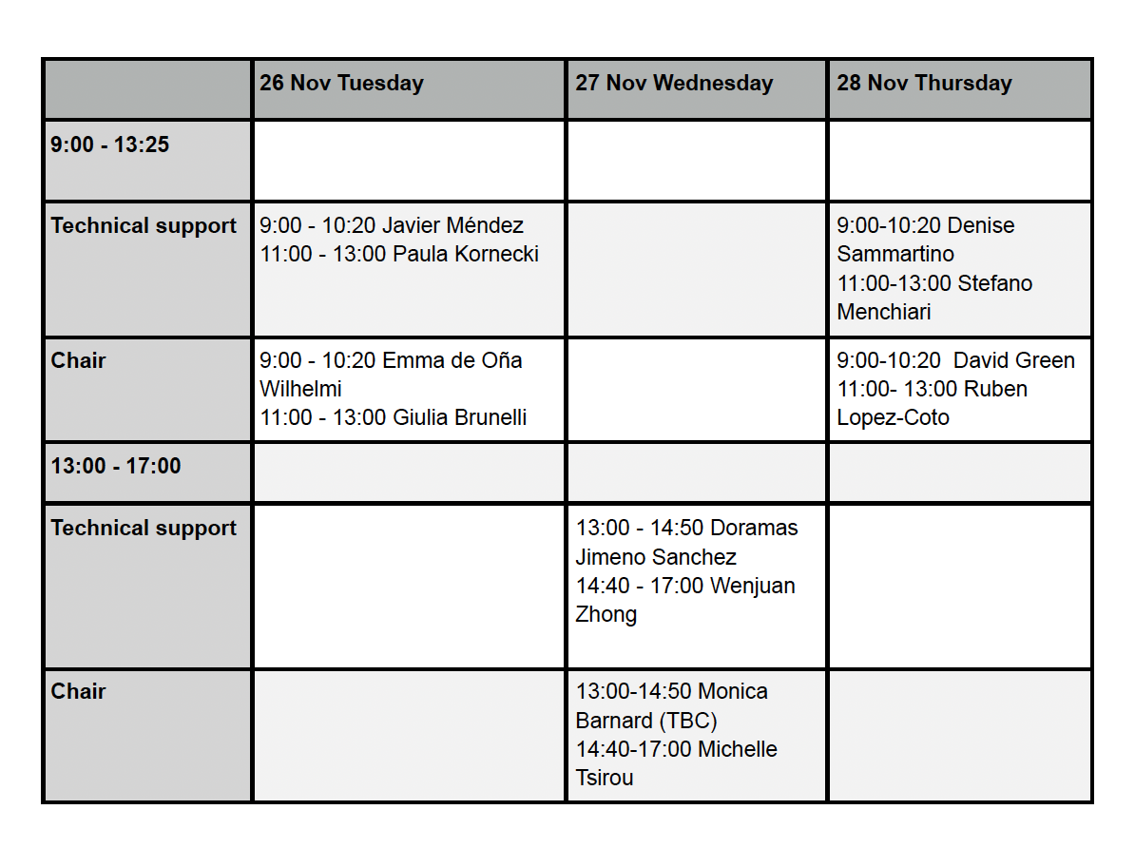
Thanks for the SOC and LOC and all the participants
Scientific Organizing Committee
Felix Aharonian (DIAS / MPIK)
Elena Amato (INAF / Osservatorio Astrofisico di Arcetri)
Patrizia Caraveo (INAF / IASF-Milano)
Benoit Cerutti (Université Grenoble Alpes)
Gianluca Giavitto (DESY Zeuthen)
Alice Harding (NASA Goddard Space Flight Center)
Nanda Rea (ICE-CSIC)
Diego Torres (ICE-CSIC)
Local Organizing Committee
Doramas Jimeno Sánchez (DESY Zeuthen)
Paula Kornecki (IAA-CSIC)
Stefano Menchiari (IAA-CSIC)
Javier Méndez-Gallego (IAA-CSIC)
Denise Sammartino (IAA-CSIC)
Wenjuan Zhong (DESY Zeuthen)
Look for .HONEST_NAME

