Slide 1
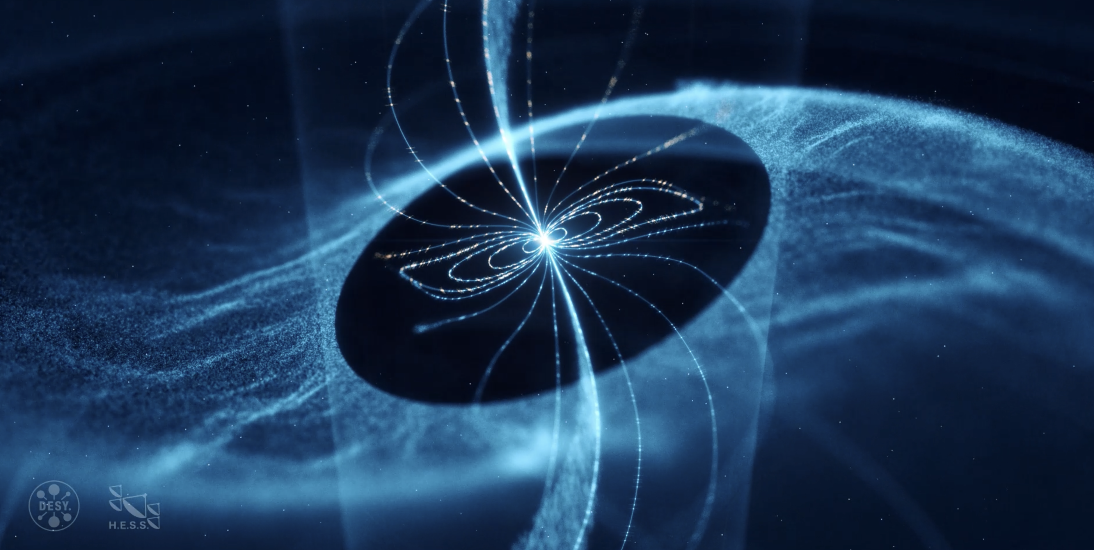

Discovery of up to 20 TeV gamma rays from the Vela pulsar with H.E.S.S.
Emma de Oña Wilhelmi* DESY Zeuthen
“
*for the H.E.S.S. collaboration (Nature Astronomy, 7, pages 1341–1350 (2023))

Slide 2
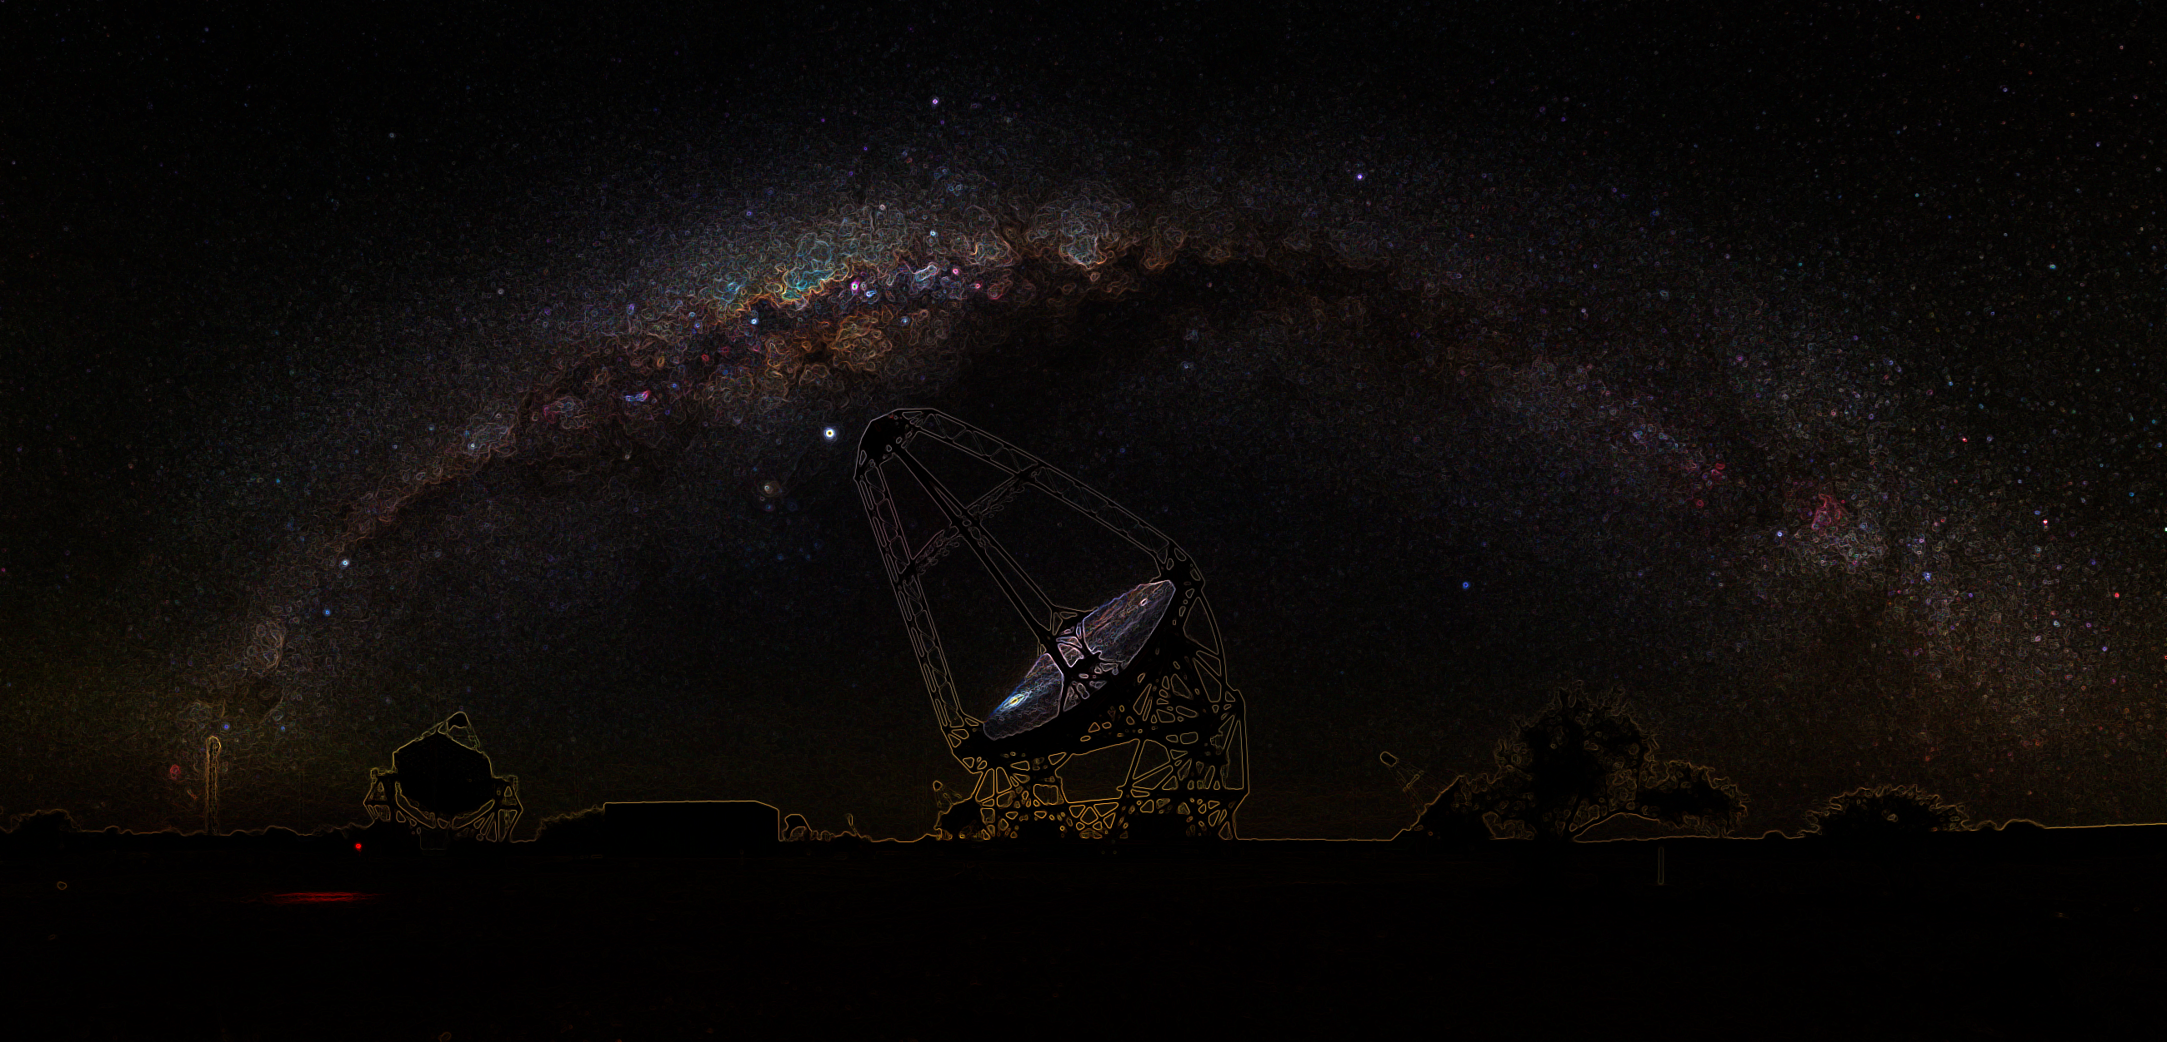
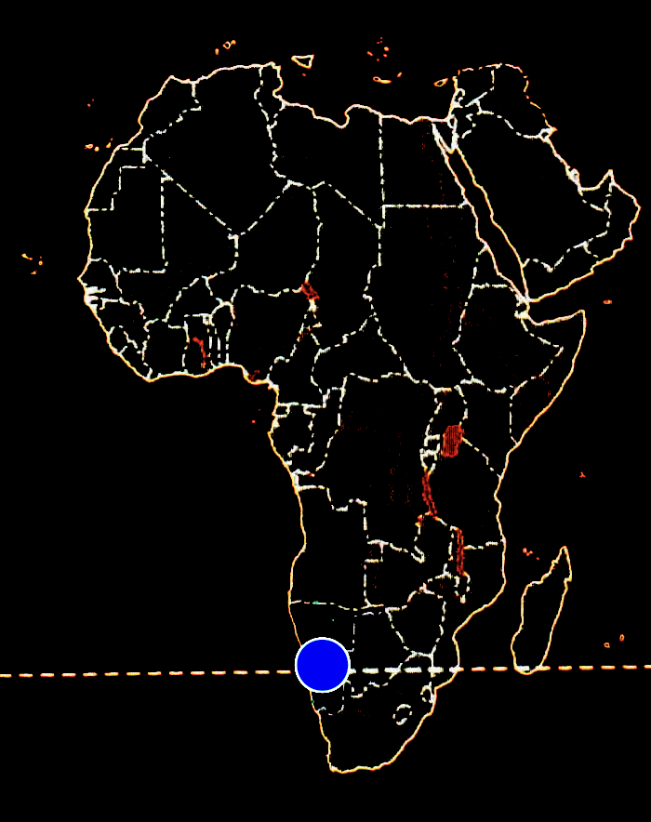
Observations with IACTs: H.E.S.S.
The HESS Experiment
Array of 5 Imaging Atmospheric Cherenkov Telescopes (IACTs), CT1-5
  4 x 12 m diameter, with a 120m baseline, CT1-4
  1 x 28 m-equivalent dish, at the center of the array, CT5
Full array energy range ~30 GeV — 100 TeV
  CT1-4 in operation since 2002: Camera Updates in 2015
  CT5-only : monoscopic mode, since 2012: FlashCam in 2020 (CTAO camera prototype)
Threshold energy < 20 GeV for pulsars

Slide 3
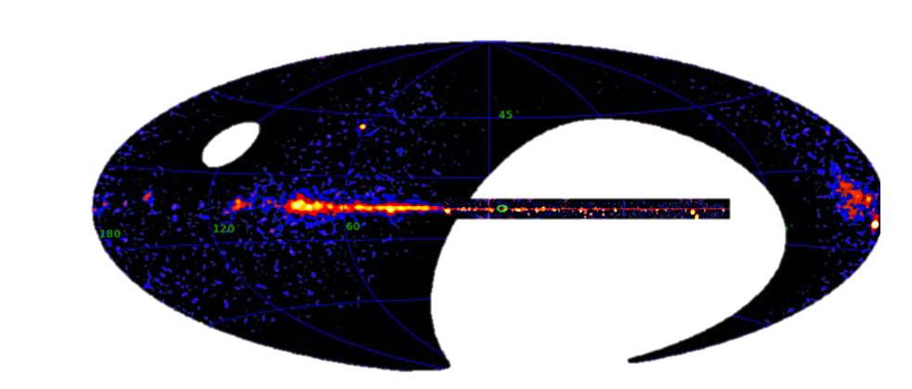
HESS + WCDA

Slide 4
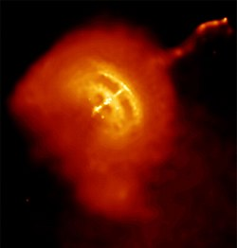
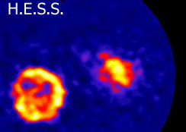
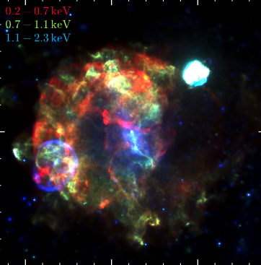
The Vela Pulsar Region
HESS + WCDA
Chandra
Vela Jr & Vela X
8 deg
Vela SNR
Nearby d=287 pc
Young pulsar 11 kyr and period of 89 ms
Ė ~ 10³⁷ erg/s
eROSITA

Slide 5
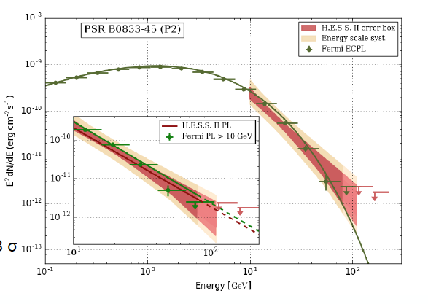
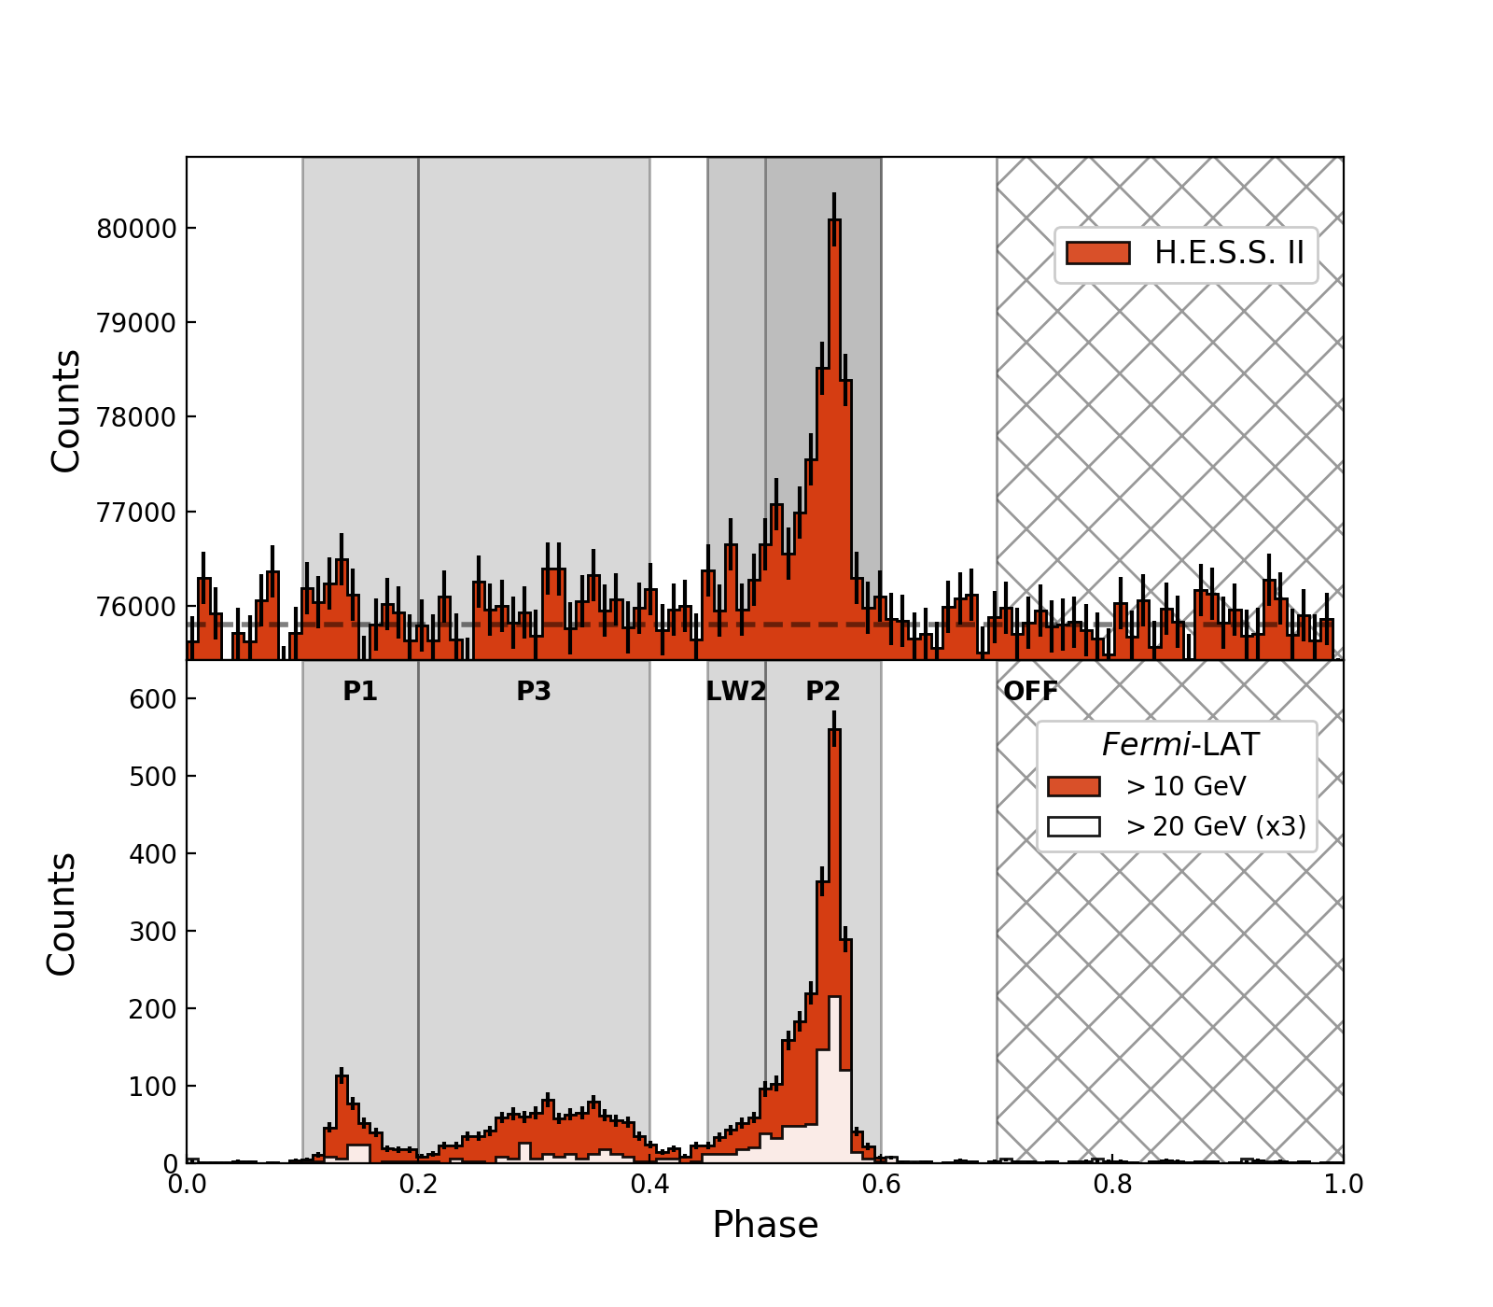
The Vela pulsar
Vela in the sub-100 GeV regime
See Maxime Regeard next talk!
Light curve with 3 peaks, with P2 becoming prominent at high energies:
Detected in 40.3 h with HESS CT5
HESS Collaboration et al 2018

Slide 6
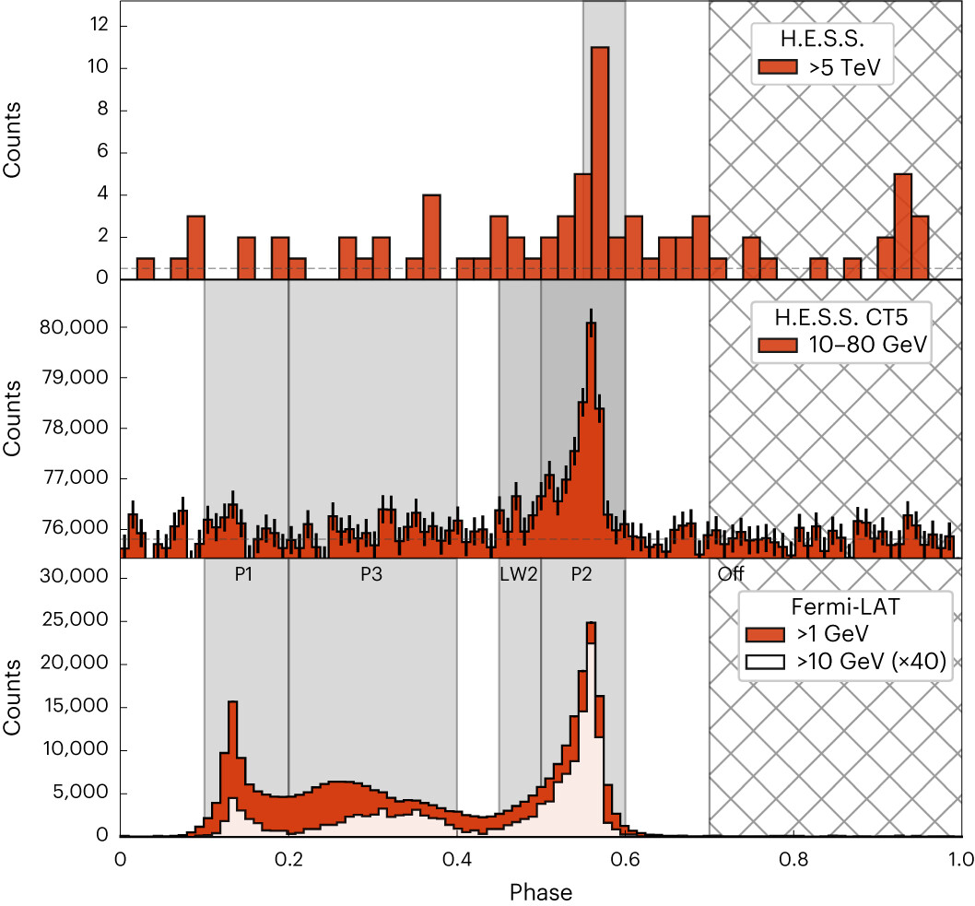
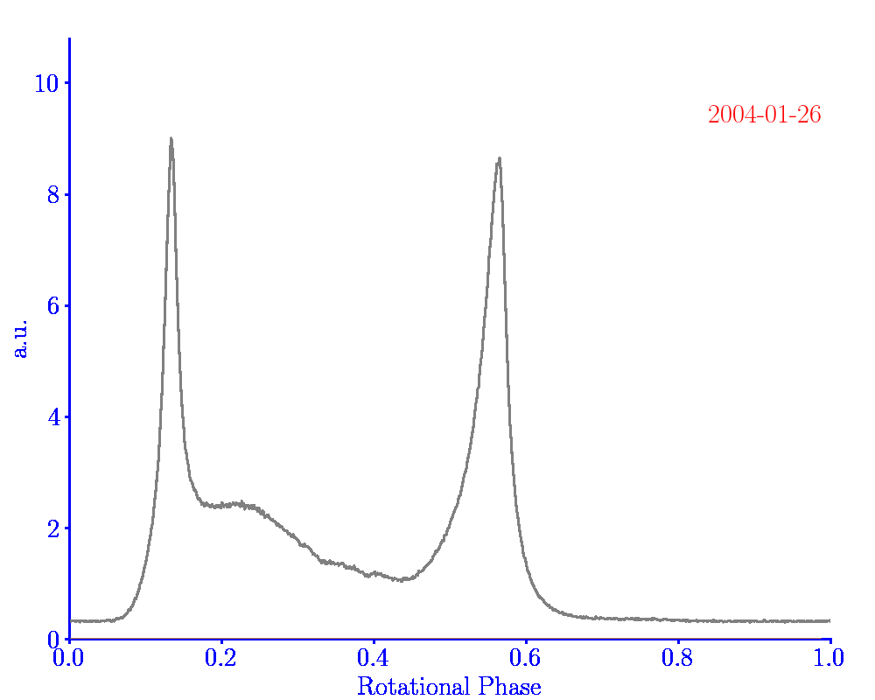
The Vela Pulsar in the TeV regime
Detection of Vela above 1 TeV
HESS Collaboration et al 2023
Data from 2004-2016 observations (80 h)
Phase-folding : ephemeris from LAT+ Parkes
(E>5 TeV)

Slide 7
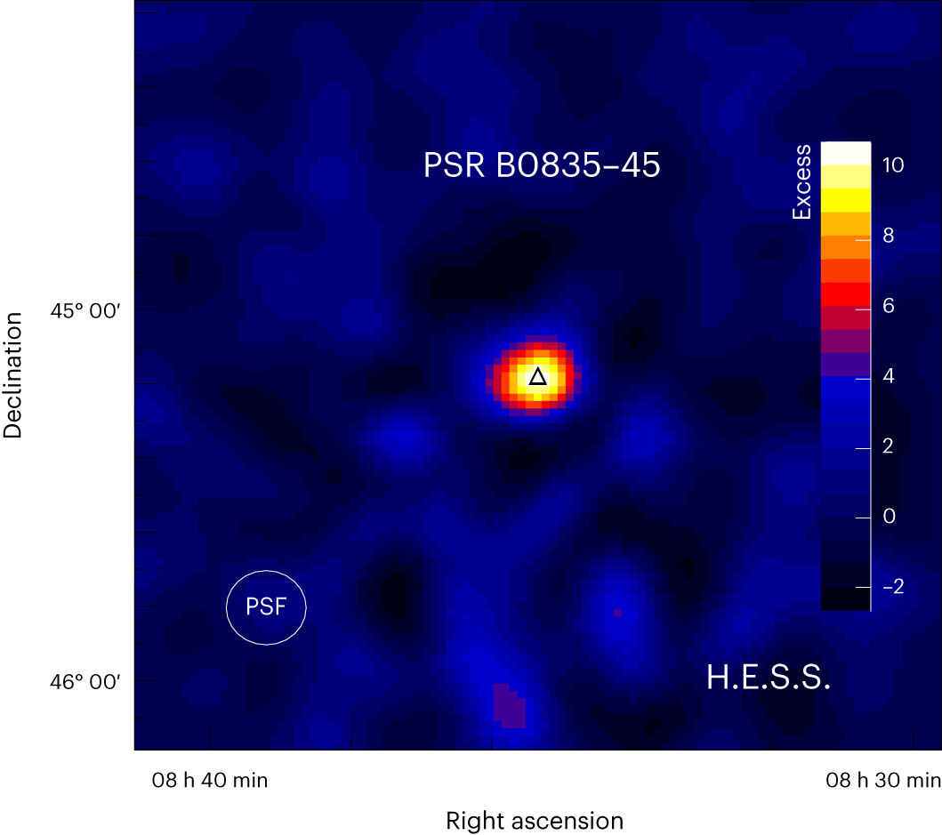
The Vela Pulsar in the TeV regime
Detection of Vela above 1 TeV
HESS Collaboration et al 2023
Data from 2004-2016 observations (80 h)
Phase-folding : ephemeris from LAT+ Parkes
(E>5 TeV)
P2 phase range

Slide 8
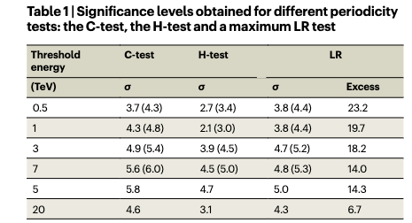
The Vela Pulsar in the TeV regime
Detection of Vela above 1 TeV
HESS Collaboration et al 2023
Data from 2004-2016 observations (80 h)
Phase-folding : ephemeris from LAT+ Parkes
Tests for periodicity @ predefined energies of
1, 3 & 7 TeV => 4.3, 4.9, 5.6 σ post-trials
Phase & width compatible with <100 GeV pulses
Pulsed emission detected up to 20 TeV

Slide 9
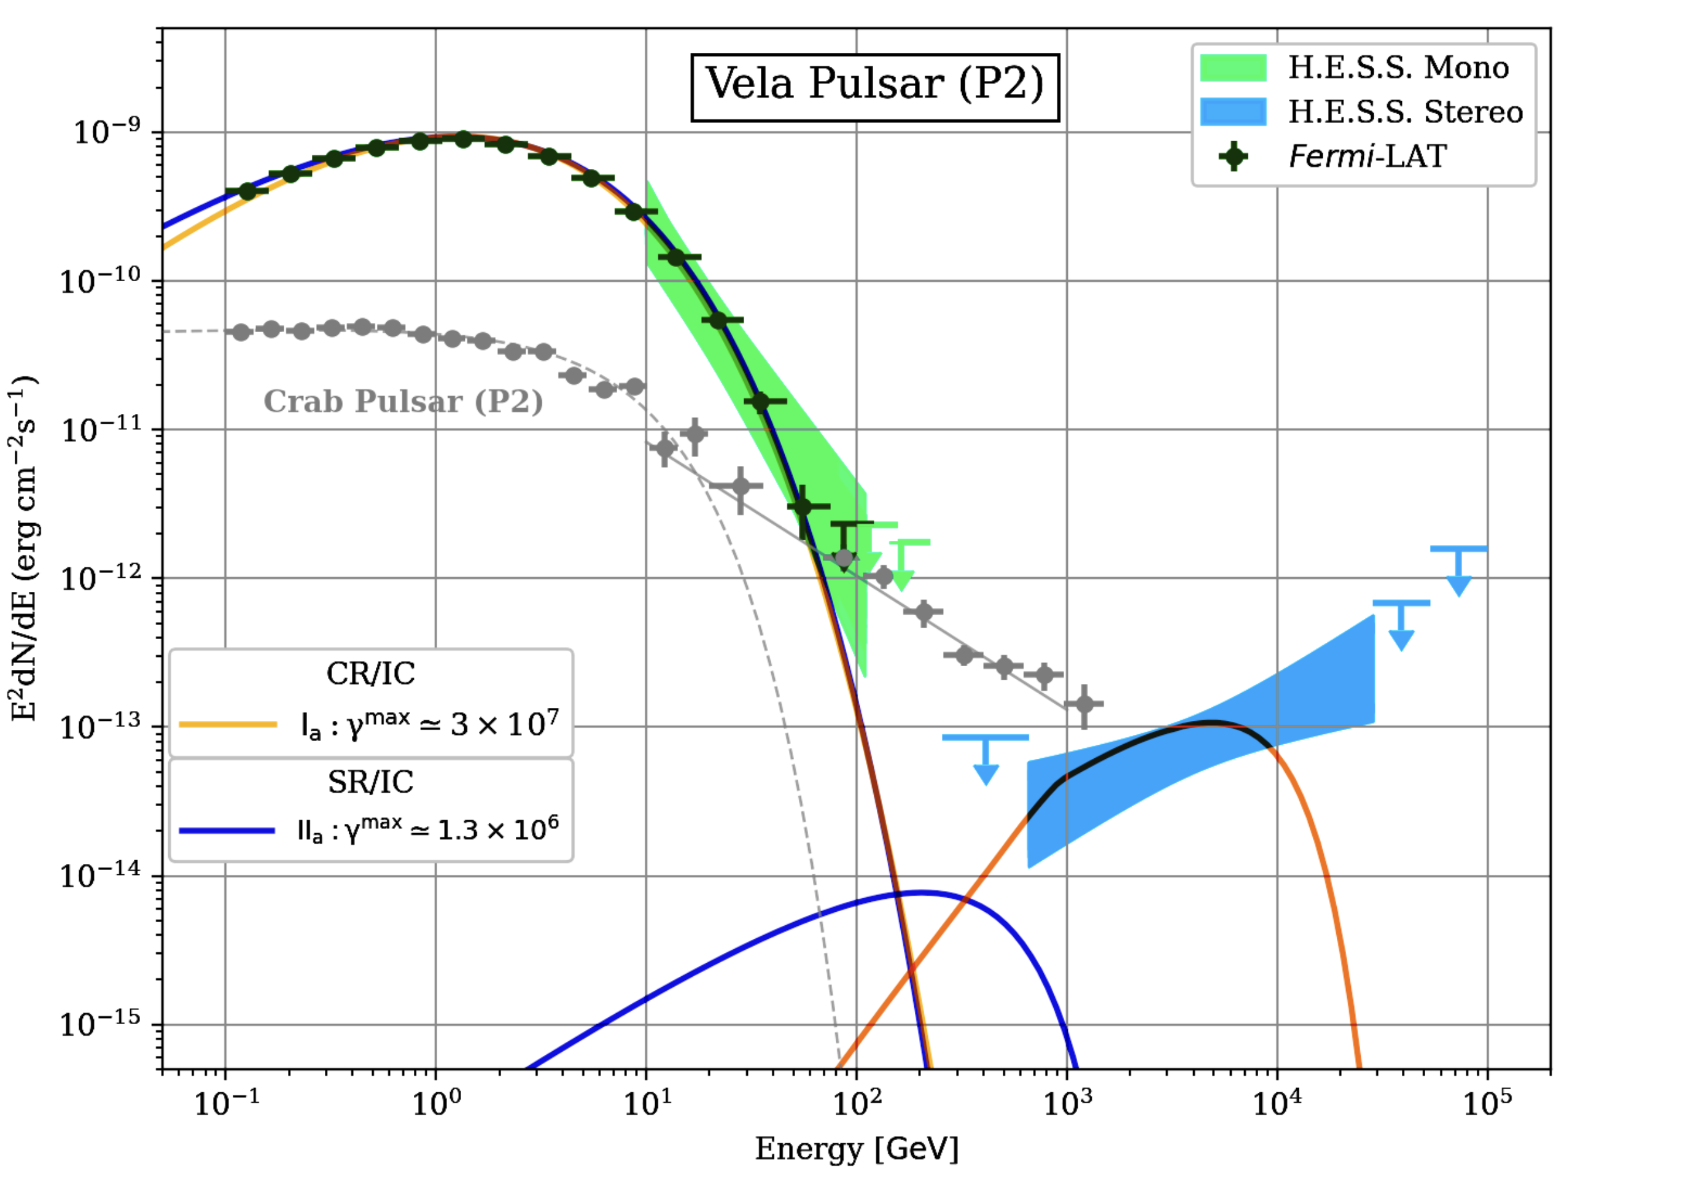
Inverse Compton
Γ=1.4± 0.3_{stat} ± 0.1_{sys}
One of the hardest TeV sources
In the K-N regime:
HESS Collaboration et al 2023

Slide 10
Curvature (CR) or Synchrotron (SR)
Inverse Compton
Γ=1.4± 0.3_{stat} ± 0.1_{sys}
One of the hardest TeV sources
In the K-N regime:
HESS Collaboration et al 2023

Slide 11
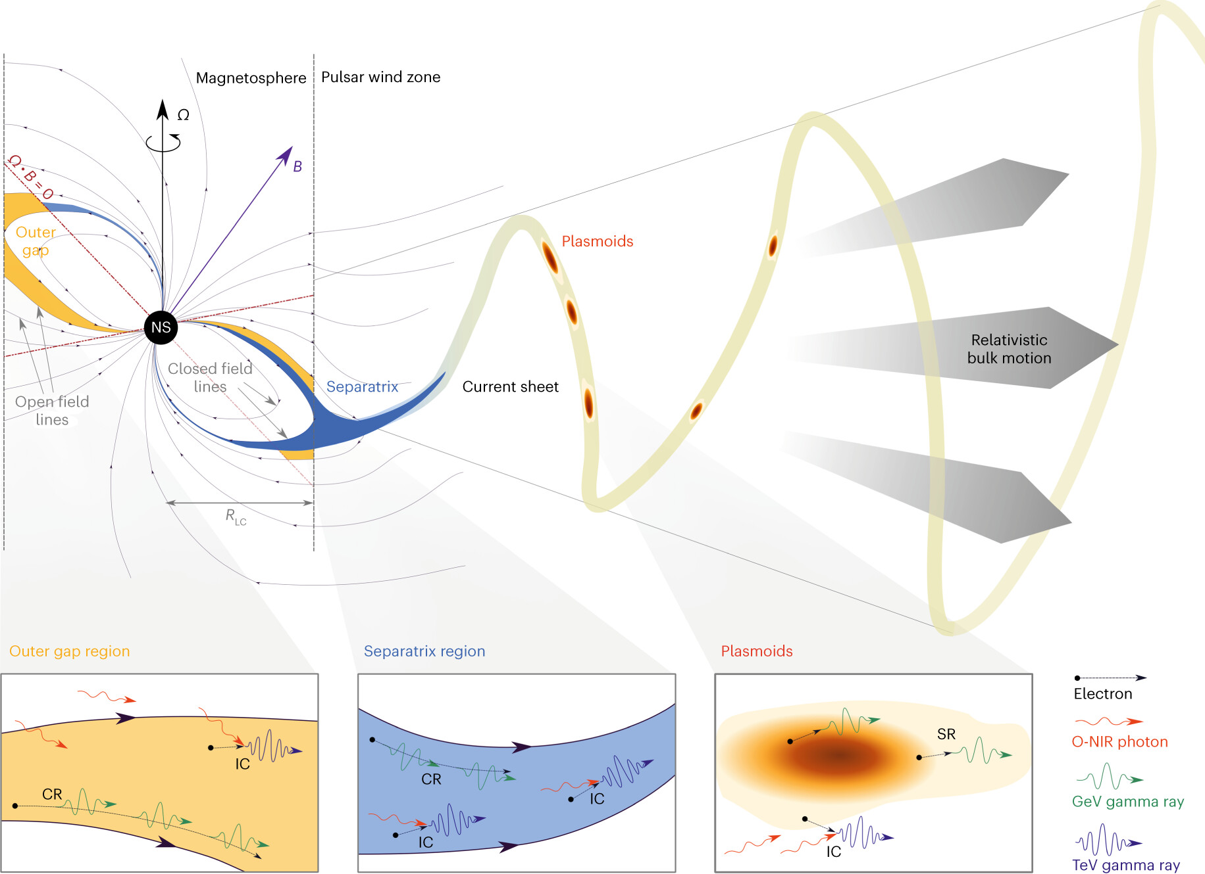
Interpretation: Heuristic Models
HESS Collaboration et al 2023

Slide 12
(i) Magnetospheric models
accelerating E||, charge
depleted zones; CR / IC
* CAVEAT:
Same particle population emitting at HE and VHE!
(ii) Wind models:
Magnetic reconnection
current sheet;
Doppler boosting; SR / IC
HESS Collaboration et al 2023

Slide 13
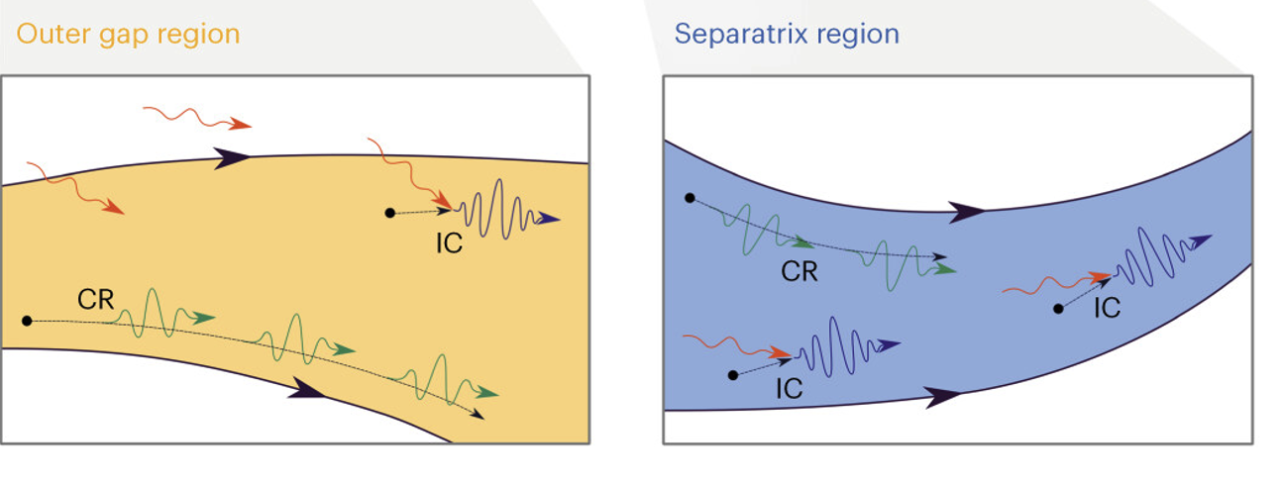
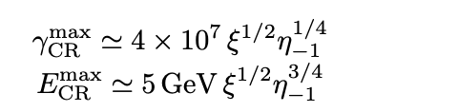
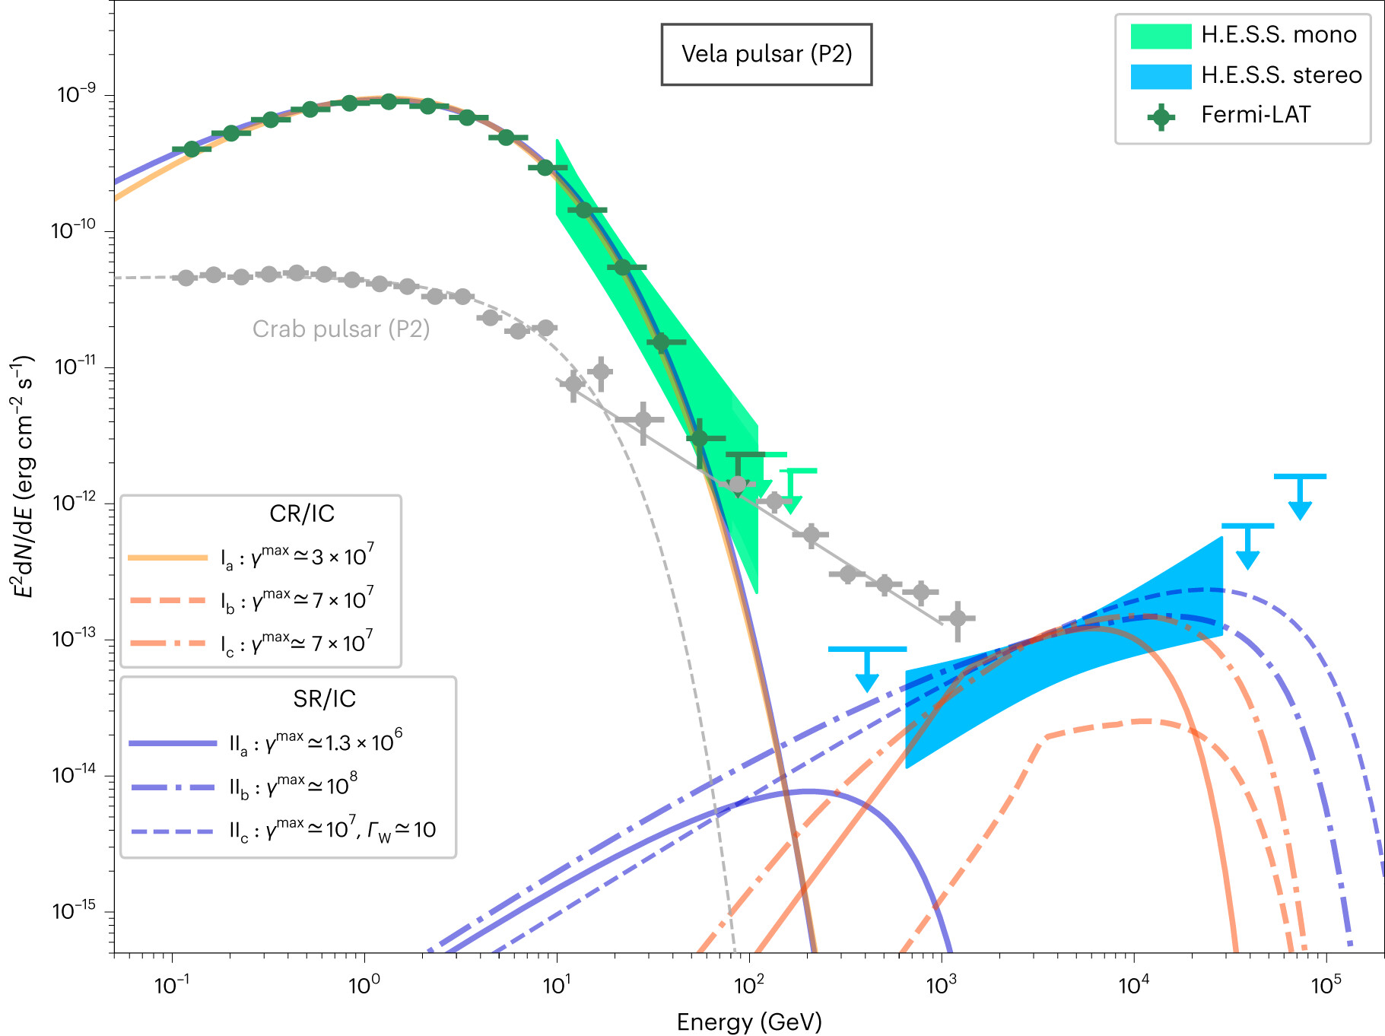
Curvature and IC Cooling
Curvature in gaps (outer gaps or separatrix/current sheets).
The maximum energy depends on the pulsar parameters, and η and 𝛏
η is magnetic conversion efficiency
ξ is ratio of curvature radius to light cylinder radius
We fit HE and VHE to constrain emission region*

Slide 14

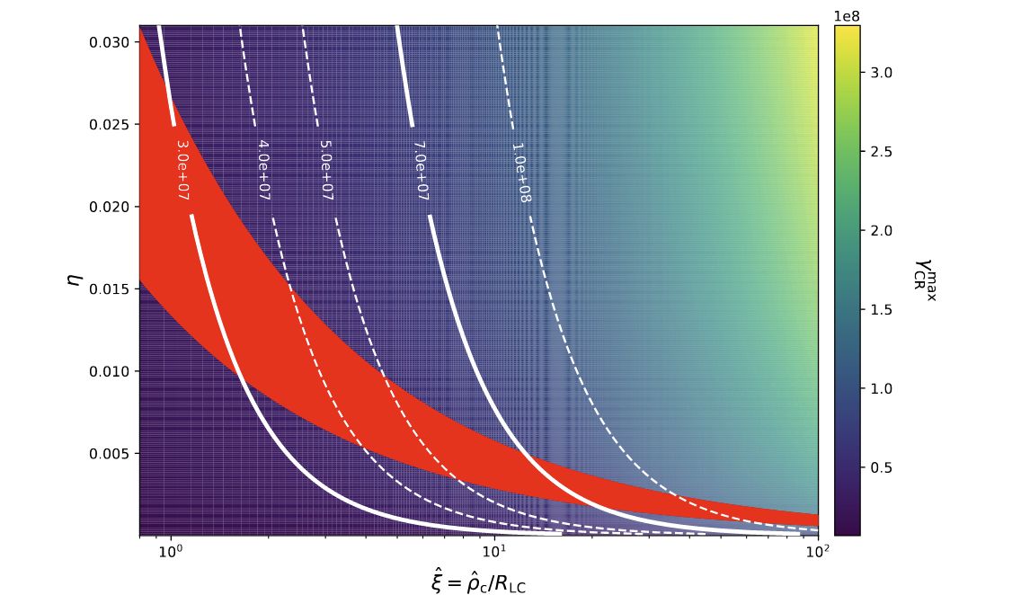
Curvature and IC Cooling
Dissipation region should happen beyond the LC where
Red band from GeV peak:
$$∈\left[1.5−2.5GeV\right]$$
Close to the LC
=>Insufficient to reach the TeV emission
The red band is defined by the error in E_{HE}^{peak}

Slide 15
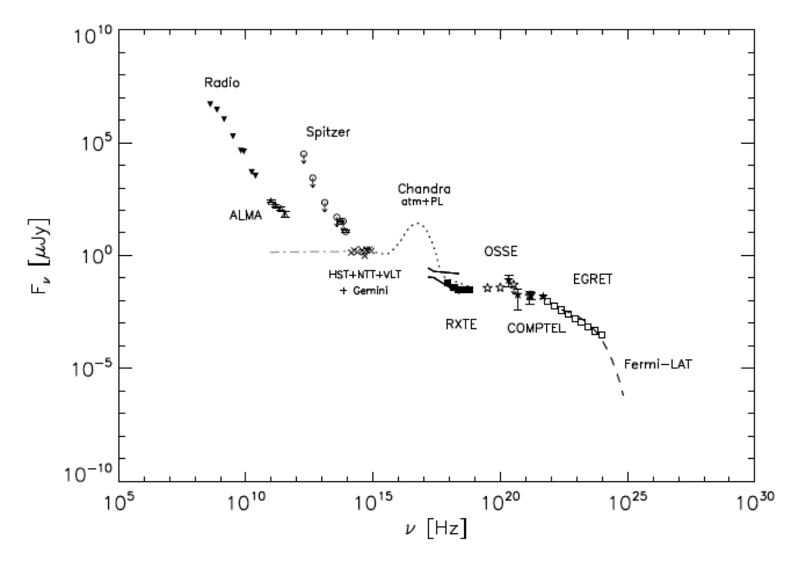
Curvature and IC Cooling
Dissipation region should happen beyond the LC where
Red band from GeV peak:
$$∈\left[1.5−2.5GeV\right]$$
To reach the TeV level, we need to extrapolate the photon field to the FIR:
Target: OP-NIR
Target: OP-FIR

Slide 16
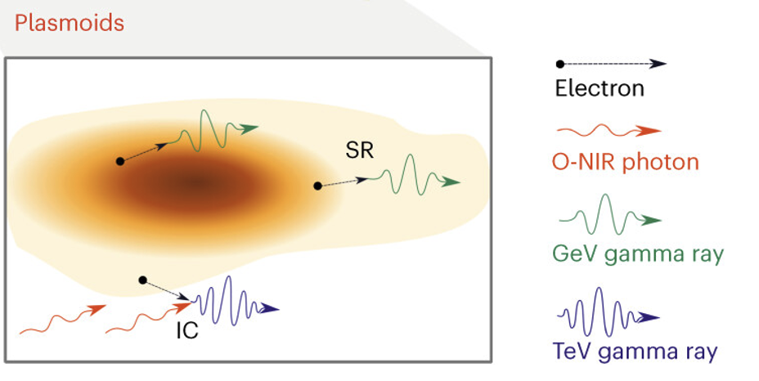

Synchrotron and IC Cooling
Synchrotron in wind plasmoids
Not enough: Escape of the highest energies? Doppler boosting emission?
=> To be investigated
Insufficient to reach the TeV emission

Slide 17
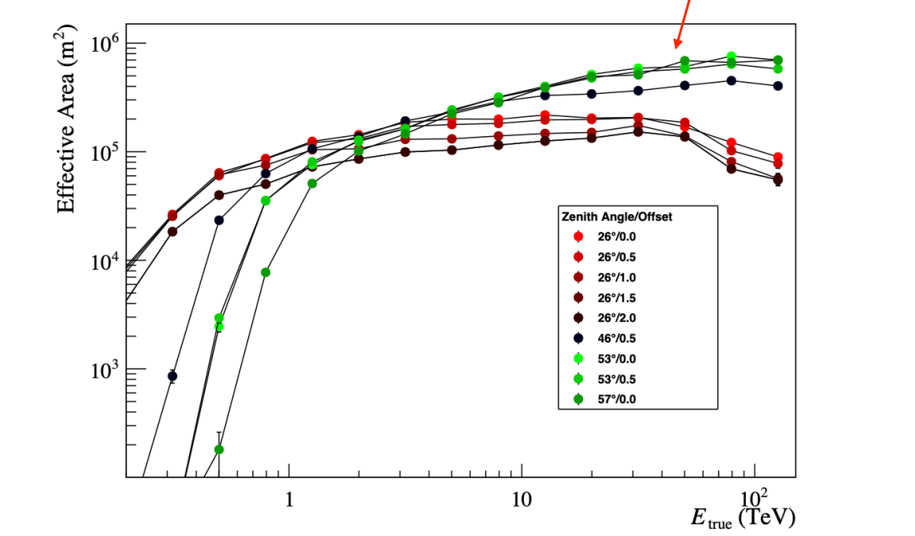
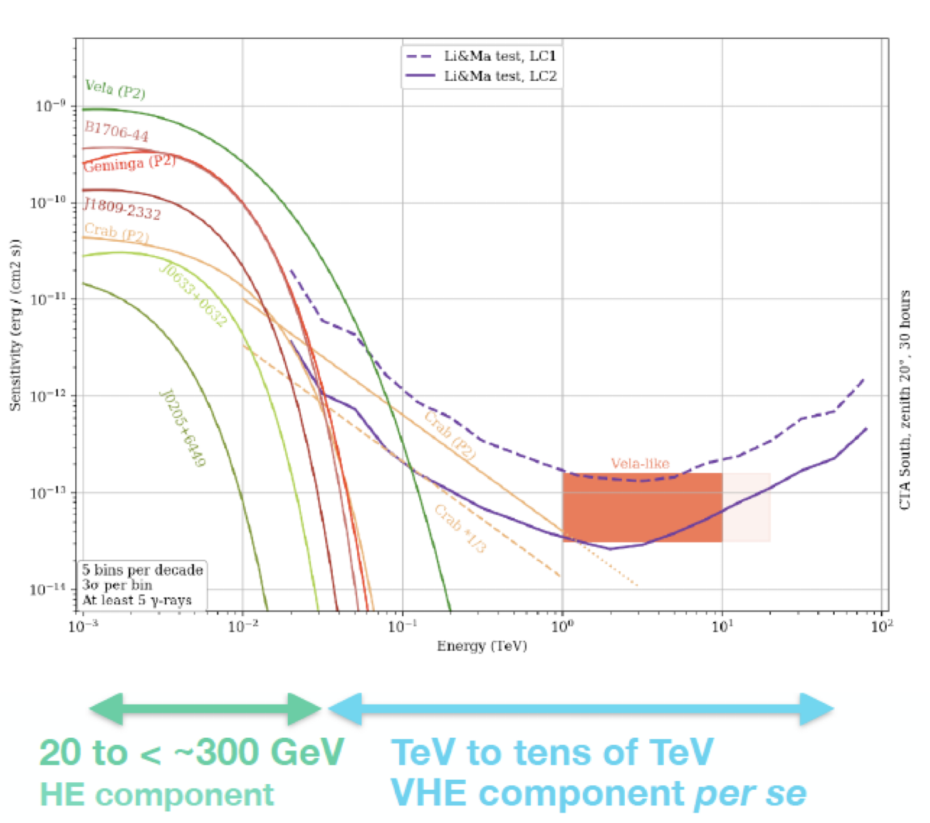
What‘s next
Into the Future
Continuing Vela pulsar observations with H.E.S.S.,
Goal: probe the >20 TeV spectrum
  => High Zenith Angle observations improve Effective
  Area > 10 TeV
Probing other promising pulsars for VHE emission
=> New observations with H.E.S.S.
Searching for VHE pulsars in H.E.S.S. archival data
Building CTA!

Slide 18
Summary
Discovery of pulsed emission from the Vela Pulsar up to 20 TeV
Vela, the first pulsar to reach tens of TeV range
In contrast to Crab, Vela displays unambiguously a new & very hard spectral component, reaching ~10 times higher energies
This discovery open more questions and boost the field of pulsars
  An unambiguous handle on Lorentz factors > 4x10⁷
  VHE emission, i.e. dissipation region beyond but close to LC (even in the Doppler-boosted scenario)
  Challenges for both CR/IC and SR/IC scenarios => to be continued!

Slide 19
